Slide 1

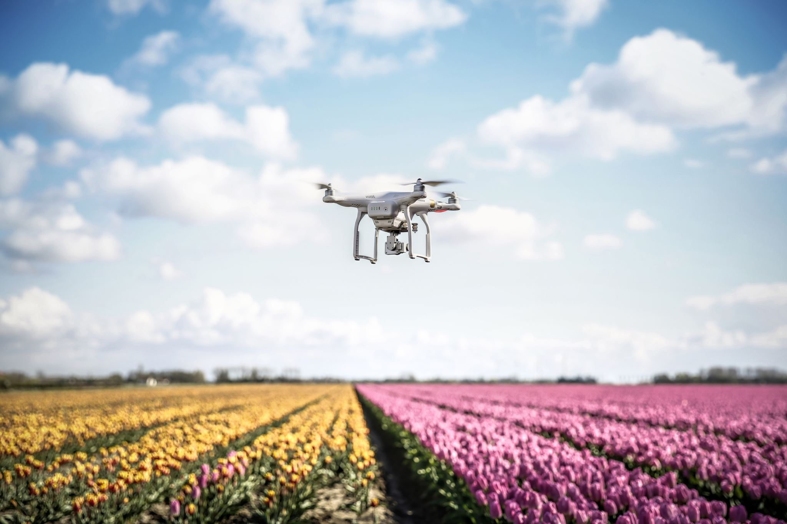

MECN4029:MECHATRONICS II QUADROTOR DRONE CONTROLLER DESIGN
GROUP 21
Osca Kholopha (1863498)
Sandiswa Nkabinde (2324218)
Thobela Mzaca (1844385)
Romeo Raleting (1419355)
https://witscloud-my.sharepoint.com/:v:/g/personal/1863498_students_wits_ac_za/EayjkRJX_CJMpeLSEp15GDsBmNvb_5dR1STjIZQnGukeGQ?e=9X2dK2&nav=eyJyZWZlcnJhbEluZm8iOnsicmVmZXJyYWxBcHAiOiJTdHJlYW1XZWJBcHAiLCJyZWZlcnJhbFZpZXciOiJTaGFyZURpYWxvZy1MaW5rIiwicmVmZXJyYWxBcHBQbGF0Zm9ybSI6IldlYiIsInJlZmVycmFsTW9kZSI6InZpZXcifX0%3D

Slide 2
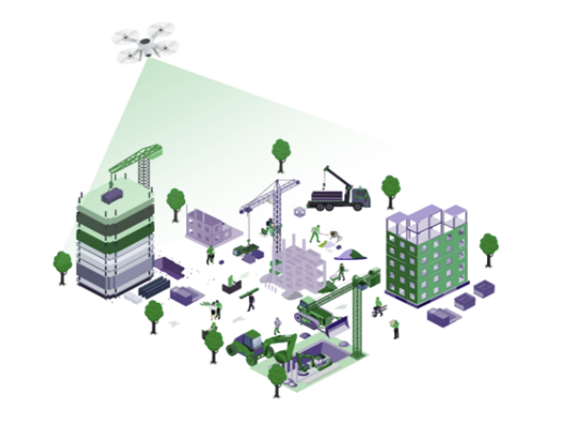
INTODUCTION AND BACKGROUND
High-rise buildings are difficult and dangerous to inspect using scaffolds, cranes, or ropes.
These methods are slow, costly, and pose risks to human inspectors.
Drones offer a safe, cost-effective, and non-invasive solution.
They provide rapid access to hard-to-reach places and enable frequent assessments

Slide 3
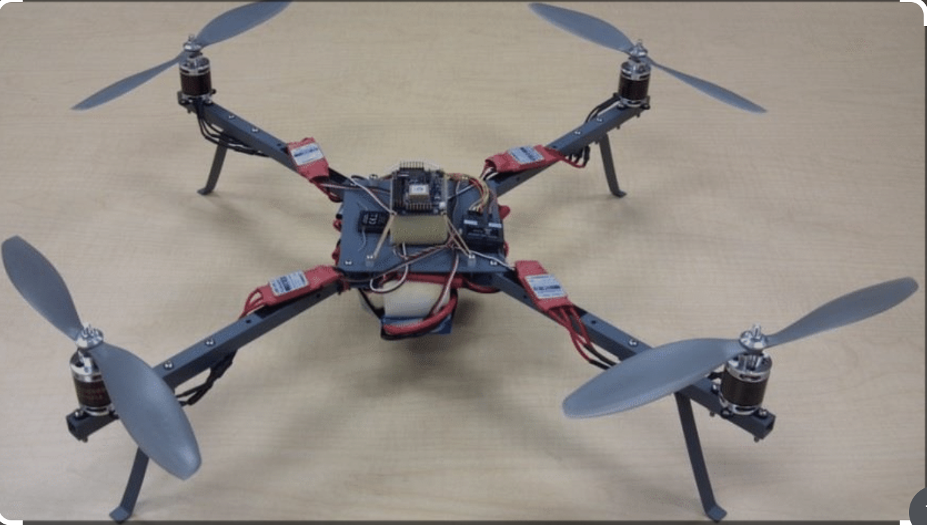
QUADROTOR DRONE SYSTEMS
A quadrotor is a type of drone with four rotors arranged in a cross configuration.
It is a mechatronic system, integrating
Mechanical structure (frame, motors, propellers)
Electronics (flight controller, battery)
Sensors (IMU, gyroscope, accelerometer)
[2]

Slide 4
CASES TO INVESTIGATION
Freehand Throw Hovering – Drone stabilizes after being launched by hand.
Recovery from Free Fall – Detects and recovers from uncontrolled descent.
Upside-Down Recovery – Reorients from inverted position to stable hover.

Slide 5
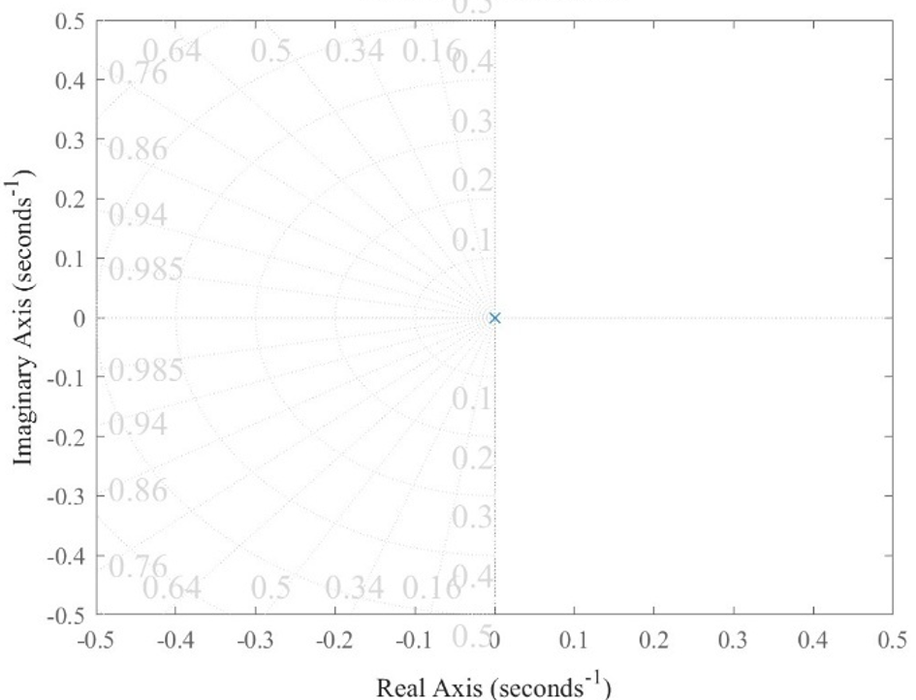

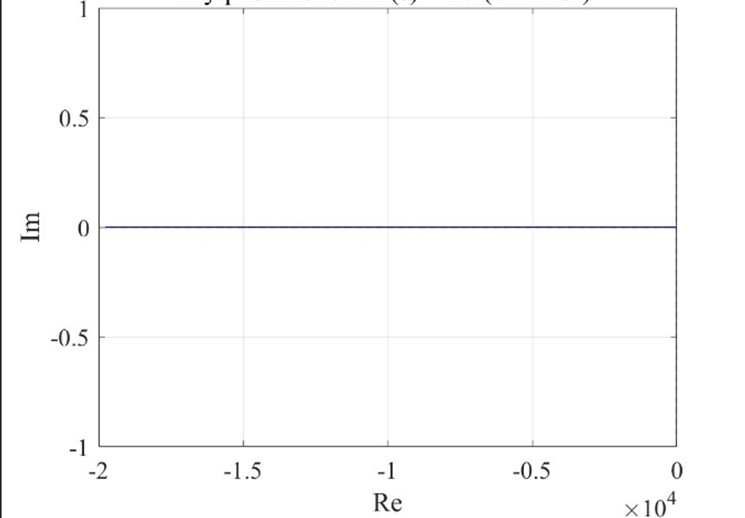
STABILITY OF THE QUADROTOR
Zero-Poles Plot
Zero-Pole Analysis: Poles at origin → Marginally stable
Nyquist & Routh-Hurwitz: Confirm marginal stability
System requires a controller to maintain hover and recover from disturbances
Nyquist Plot

Slide 6
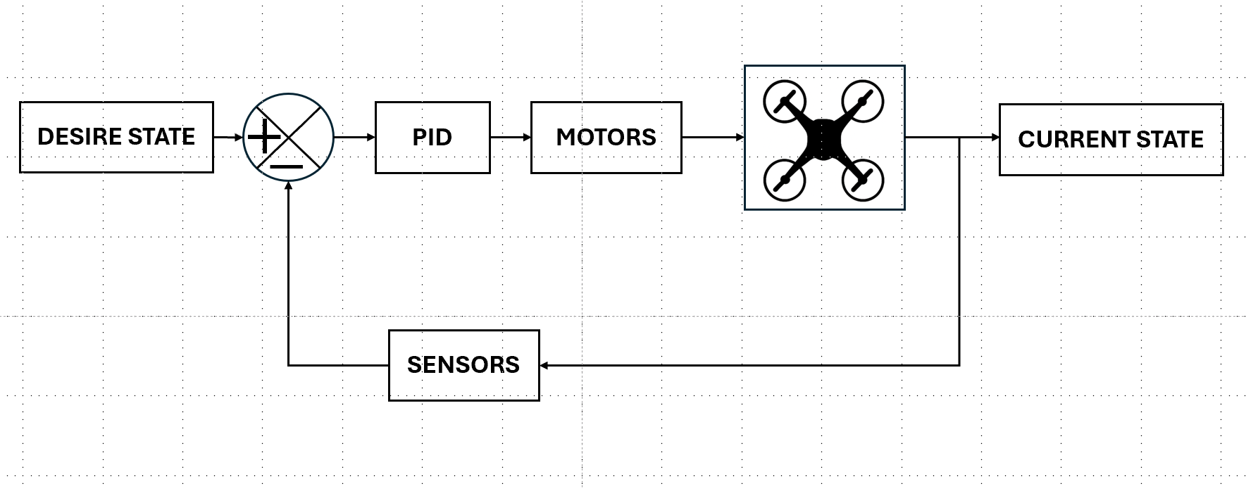
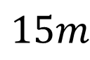
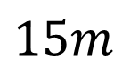
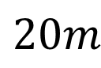
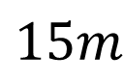
DESIGNED CONTROL SYSTEM
$$20m$$
Motor speed increases
Error=5m
$$15m$$
$$15m$$
$$15m$$

Slide 7








HOVERING FROM FREE-FALL
Free fall state
Hovering state

Slide 8
MAINTAINING HOVER AFTER AGGRESSIVE INPUTS
Aggressive input state
Hovering state

Slide 9
HOVERING FROM FREE HAND THROW
Upside-Down state
Hovering state

Slide 10
REFERENCES
[1] GarudaUAV, “GarudaUAV Official Website.” [Online]. Available: https://garudauav.com/. [Accessed May 20, 2025].
[2] Fiaz, Usman A. & Mukarram, Aniqa & Khan, Uzair. (2015). Altitude Control of a Quadcopter.

